Slide 1
ARTIFICAL INTELLIGENCE (AI)

Slide 2
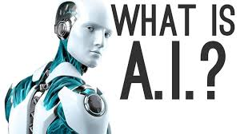
INTRODUCTION
WHAT IS ARTIFICAL INTELLIGENCE

Slide 3
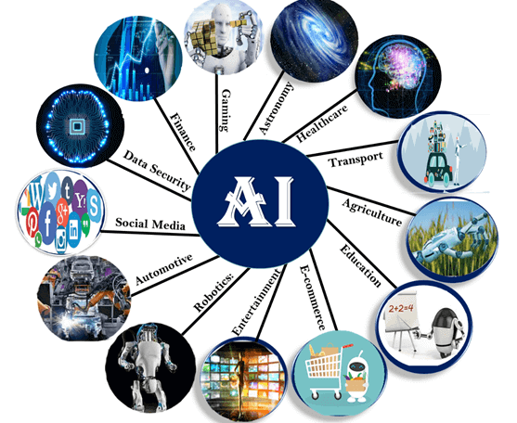
Application of ai
Applications:
AI in astronomy
AI in Healthcare
Ai in Gaming
AI in Finance
AI in Data Security
AI in Social Media
AI in Travel & Transport
AI in automotive Industry
AI in Robotics
AI in Entertainment
AI in Agriculture
AI in E-commerce
AI in education

Slide 4
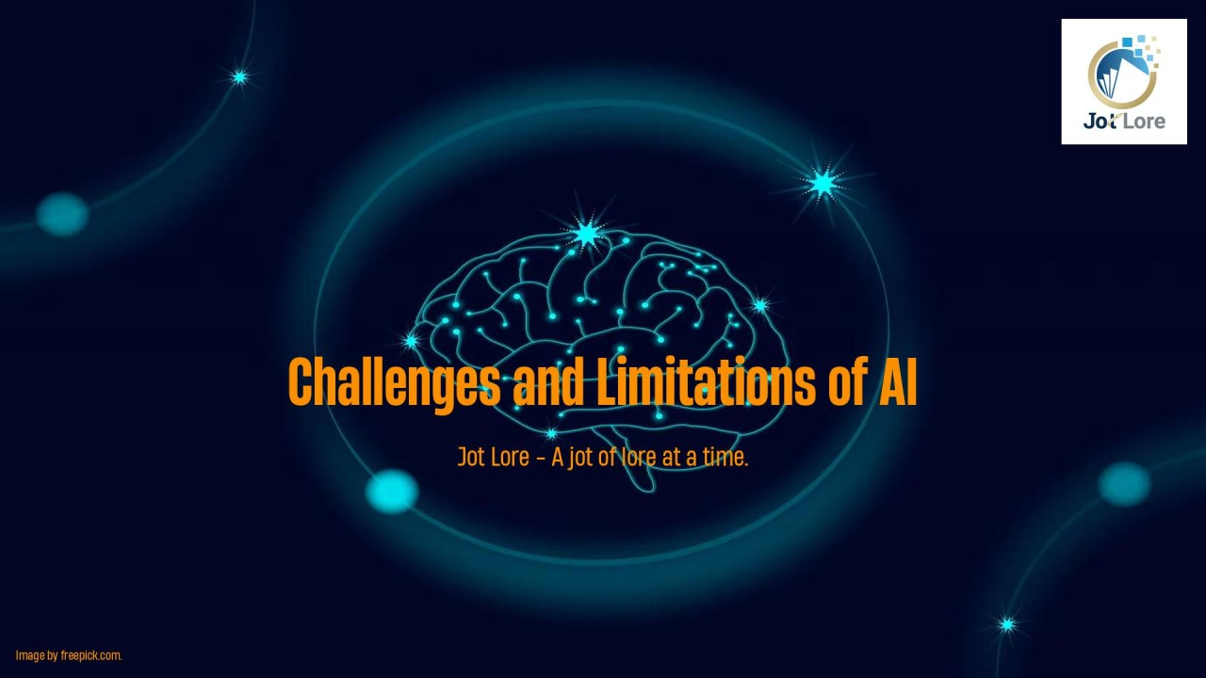
Challenges and limitatons
Challenges and Limitations of AI
Data Dependency:
Explainability and Transparency
Generalization vs. Specialization
Ethical and Societal Implications
Reliability and Safety
Human and AI Interaction:
The Barrier of Common Sense

Slide 5
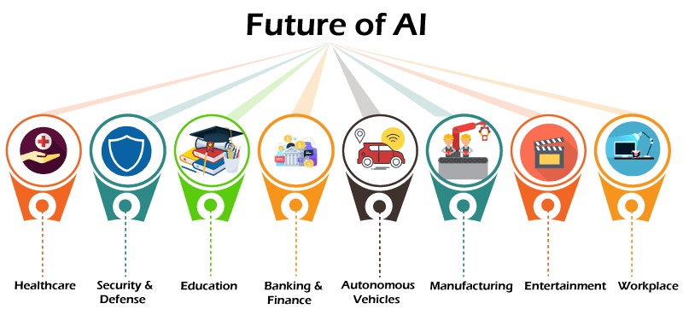
Future outlook
How will AI Impact The Future.
Speed of life
End of privece
Thicket of AI look
Human AI teaming
Which industries will AI have a big impact on?
Education
Health and Care
Fineces
Law
Trosporatation

Slide 6
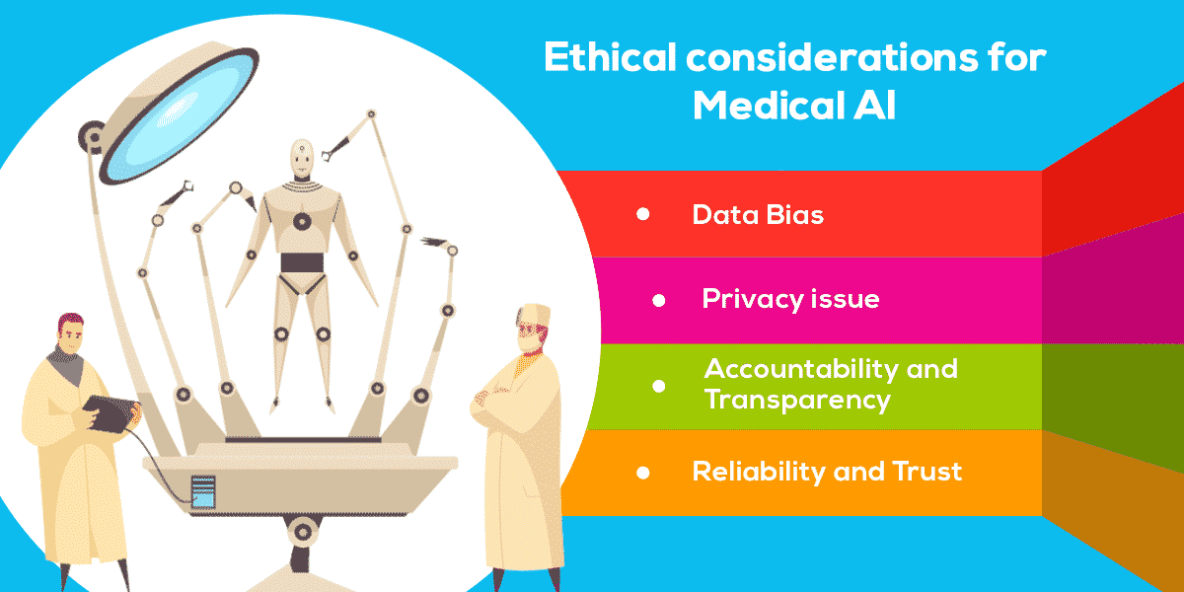
Ethical consideration
Top 10 Ethical Considerations of AI
Fairness and bias
Trasparncy
Privacy
Safety
Explainability
Human oversight
Trustworthiness
Human centered deasing
Responsibility
Considerthed long term impact of AI

Slide 7

Conclusion
AI holds the key to unlocking a magnificent future where, driven by data and computers that understand our world, we will all make more informed decisions. These computers of the future will understand not just how to turn on the switches but why the switches need to be turned on.

Slide 8
THANK YOU

